Slide 1
Prolog
Lab 2

Slide 2
Ahmed
Kareem
Ali
Ola
Soha
Mohamed
Sarah
Omar
Amr
Mona
Make a PROLOG program that represents the family tree that contains the following relations (
).
male
female
parent
father
mother
brother
sister
grandfather
grandmother
uncle
aunt
cousin
son
daughter

Slide 3
Family tree example
predicates
nondeterm male(symbol)
nondeterm female(symbol).
nondeterm father(symbol,symbol)
nondeterm mother(symbol,symbol)
nondeterm parent(symbol,symbol)
clauses
male(ahmed).
male(mohamed).
male(kareem).
male(ali).
male(omar).
male(amr).
female(ola).
female(mona).
female(sarah).
parent(ahmed,kareem).
parent(ahmed,ali).

Slide 4
Family tree example
predicates
nondeterm male(symbol)
nondeterm female(symbol).
nondeterm father(symbol,symbol)
nondeterm mother(symbol,symbol)
nondeterm parent(symbol,symbol)
clauses
parent(ahmed,ola).
parent(kareem,soha).
parent(kareem,mohamed).
parent(ali,sarah).
parent(ali,omar).
parent(ola,amr).
parent(ola,mona).
mother(X,Y):-female(X),parent(X,Y).
father(X,Y):-male(X),parent(X,Y).
Notes:
Trace the goals: father(ahmed, kareem).
father(kareem,X).
father(X,ola).
father(ahmed,_).%underscore is “anonymous variable” (don’t care) (anything). So the question is: is ahmed a father?
father(X,_). %get all fathers (what question)

Slide 5
Family tree example
Please try implementing the following clauses
  Grandfather
  Grandmother

Slide 6
Family tree example
predicates
nondeterm grandfather(symbol,symbol)
nondeterm grandmother(symbol,symbol)
clauses
grandfather(X,Y):-
male(X),parent(X,Z),
parent(Z,Y).
grandmother(X,Y):-
female(X),parent(X,Z),
parent(Z,Y).
X
Z
Y

Slide 7
Family tree example
predicates
nondeterm grandfather(symbol,symbol)
nondeterm grandmother(symbol,symbol)
clauses
grandfather(X,Y):-father(X,Z),parent(Z,Y).
grandmother(X,Y):-mother(X,Z),parent(Z,Y).

Slide 8
Family tree example
Please try implementing the following clauses
  Brother
  Sister

Slide 9
Family tree example
predicates
nondeterm sister(symbol,symbol)
nondeterm brother(symbol,symbol)
clauses
sister(X,Y):-female(X),parent(Z,X),
parent(Z,Y),X<>Y.
brother(X,Y):-male(X),parent(Z,X),
parent(Z,Y),X<>Y.
z
x
Y
Notes:
X<>Y because on tracing we find that parent(Z,X) first match with Z=ahmed and X=kareem , then parent(Z,Y)=parent(ahmed,Y) (Z is bounded). parent(ahmed,Y) first matches also with y=kareem so without the condition X<>Y the program with display that kareem is brother of kareem

Slide 10
Family tree example
Please try implementing the following clauses
  Uncle
  Aunt

Slide 11
Family tree example
predicates
nondeterm uncle(symbol,symbol)
nondeterm aunt(symbol,symbol)
clauses
uncle(X,Y):-brother(X,Z),parent(Z,Y).
aunt(X,Y):-sister(X,Z),parent(Z,Y).
x
Z
Y

Slide 12
Family tree example
goal
grandfather(X,Y).
grandmother(X,Y).
sister(X,Y).
brother(X,Y).
uncle(X,Y).
aunt(X,Y).
Notes:
Please let the students try these goals

Slide 13
Cut off and fail
Goal
  Yes/No question -> stops when finds a solution
  What question -> gets all the possible solutions
How to force (Yes/No) question to get all possible solutions?
How to force (What) question to get some of the solutions only?
To do this we need
  Fail keyword -> enforces the backtracking
  ! operator -> prevents the backtracking

Slide 14
Example on Fail
Predicates
father(symbol,symbol)
run
Clauses
father(ahmed,ali).
father(ali,kareem).
father(ahmed,mona).
run:-father(X,Y),write(X,”is the father of ”, Y),nl.
Notes:
Ahmed is the father of ali only one solution

Slide 15
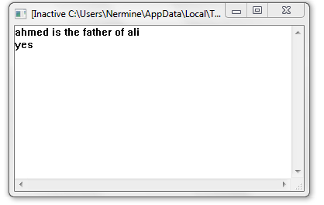
Goal
run.

Slide 16
Example on Fail
Predicates
father(symbol,symbol)
run
Clauses
father(ahmed,ali).
father(ali,kareem).
father(ahmed,mona).
run:-father(X,Y),write(X,”is the father of ”, Y),nl,
fail.
Notes:
When we put fail we force the program to get all of the possible values because of its false so it go to get all of the rest

Slide 17
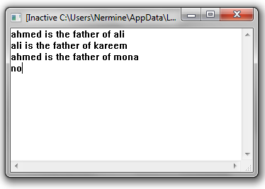
Goal
run.

Slide 18
Example on Fail
Predicates
father(symbol,symbol)
run
Clauses
father(ahmed,ali).
father(ali,kareem).
father(ahmed,mona).
run:-father(X,Y),write(X,”is the father of ”, Y),nl,
fail.
run.

Slide 19
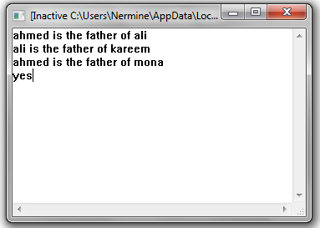
Goal
run.

Slide 20
Example on Cut off (!)
predicates
nondeterm car(symbol,symbol,integer)
nondeterm buycar(symbol,symbol)
nondeterm color(symbol,symbol)
clauses
car(mazda,green,25000).
car(fiat,black,24000).
car(dogan,red,24000).
car(marcedes,red,23000).
color(red,nice).
color(black,wonderful).
color(green,wonderful).
buycar(M,C):-car(M,C,P),P<=25000,
color(C,nice).
buycar(M,C):-
car(M,C,P),
color(C,wonderful).
Notes:
The rule is to buy a car which price is less than or equal 25000 and of a nice color OR to buy a car of any price with a wonderful color.
That’s why in the second rule we can put _ instead of P because we “don’t care” about the price

Slide 21
Example on Cut off (!)
predicates
nondeterm car(symbol,symbol,integer)
nondeterm buycar(symbol,symbol)
nondeterm color(symbol,symbol)
clauses
car(mazda,green,25000).
car(fiat,black,24000).
car(dogan,red,24000).
car(mercedes,red,23000).
color(red,nice).
color(black,wonderful).
color(green,wonderful).
buycar(M,C):-car(M,C,P),P<=25000,
color(C,nice).
buycar(M,C):-
car(M,C,_),
color(C,wonderful).
Notes:
The rule is to buy a car which price is less than or equal 25000 and of a nice color OR to buy a car of any price with a wonderful color.
That’s why in the second rule we can put _ istead of P because we “don’t care” about the price

Slide 22
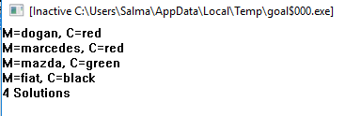
goal
buycar(X,Y).

Slide 23
Example on Cut off (!)
predicates
nondeterm car(symbol,symbol,integer)
nondeterm buycar(symbol,symbol)
nondeterm color(symbol,symbol)
clauses
car(mazda,green,25000).
car(fiat,black,24000).
car(dogan,red,24000).
car(marcedes,red,23000).
color(red,nice).
color(black,wonderful).
color(green,wonderful).
buycar(M,C):-car(M,C,P), !, P<=25000,
color(C,nice).
buycar(M,C):-
car(M,C,_),
color(C,wonderful).
Notes:
Cut off prevents implementing rule of the same name when it done

Slide 24
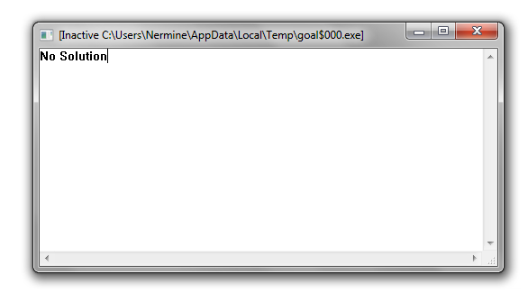
goal
buycar(X,Y).

Slide 25
Example on Cut off (!)
predicates
nondeterm car(symbol,symbol,integer)
nondeterm buycar(symbol,symbol)
nondeterm color(symbol,symbol)
clauses
car(mazda,green,25000).
car(fiat,black,24000).
car(dogan,red,24000).
car(marcedes,red,23000).
color(red,nice).
color(black,wonderful).
color(green,wonderful).
buycar(M,C):-car(M,C,P),P<=25000,!,
color(C,nice).
buycar(M,C):-
car(M,C,_),
color(C,wonderful).

Slide 26
goal
buycar(X,Y).

Slide 27
Example on Cut off (!)
predicates
nondeterm car(symbol,symbol,integer)
nondeterm buycar(symbol,symbol)
nondeterm color(symbol,symbol)
clauses
car(mazda,green,25000).
car(fiat,black,24000).
car(dogan,red,24000).
car(marcedes,red,23000).
color(red,nice).
color(black,wonderful).
color(green,wonderful).
buycar(M,C):-car(M,C,P),P<=25000,
color(C,nice),!.
buycar(M,C):-
car(M,C,_),
color(C,wonderful).
Notes:
Cut off executed when the preceding condition is done

Slide 28
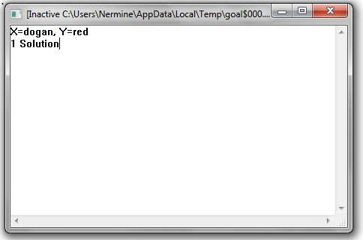
goal
buycar(X,Y).

Slide 29
What is the Output
Consider the following piece of cut-free code
a(1).
b(1).
b(2).
c(2).
d(2).
e(2).
f(3).
p(X):-a(X).
p(X):-b(X),c(X),d(X),e(X).
p(X):-f(X).
Goal
P(X).
Notes:
X=1
X=2
X=3
% first rule X=1
%second rule b (X)➔ X=1 then search for c(X) at X=1 ➔ not found then go back for backtracking to change value of of b(X)(next value foo2) at X=2 then
C(X) at X=2 ➔found then d(X) at X=2 ➔found ➔then e(X) at X=2 found all condition is true so X=2
%third rule f(X) at X=3 ➔found

Slide 30
With !
a(1).
b(1).
b(2).
c(2).
d(2).
e(2).
f(3).
p(X):-a(X).
p(X):-b(X),c(X),!,d(X),e(X).
p(X):-f(X).
goal
p(X)
Notes:
X=1
X=2

Slide 31
Quiz #1

Slide 32
Thank You

